Slide 1
Data analysis
with Python

Slide 2
Why Data Analysis?
Data is everywhere.
Data analysis/data science helps us answer questions from data.
Data analysis plays an important role in:
Discovering useful information
Answering questions
Predicting future or the unknown

Slide 3
Sakib wants to sell his car
How much money should he sell his car for?
🧑🏼 🚗
The price he sets should not be too high,
but not too low either.

Slide 4
Estimate used car prices
How can we help Tom determine the best price for his car?
Is there data on the prices of other cars and their
characteristics?
What features of cars affect their prices?
Color? Brand? Horsepower? Something else?
Asking the right questions in terms of data

Slide 5
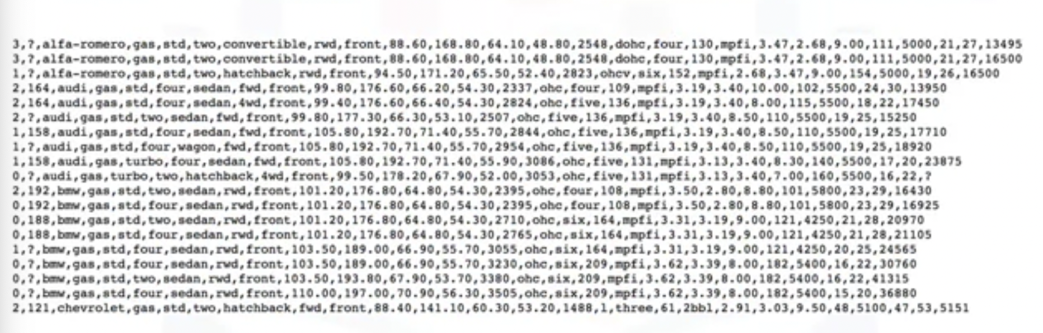
Data on used car prices

Slide 6
Understanding the Data

Slide 7
Dataset – Used Automobiles (CSV)

Slide 8
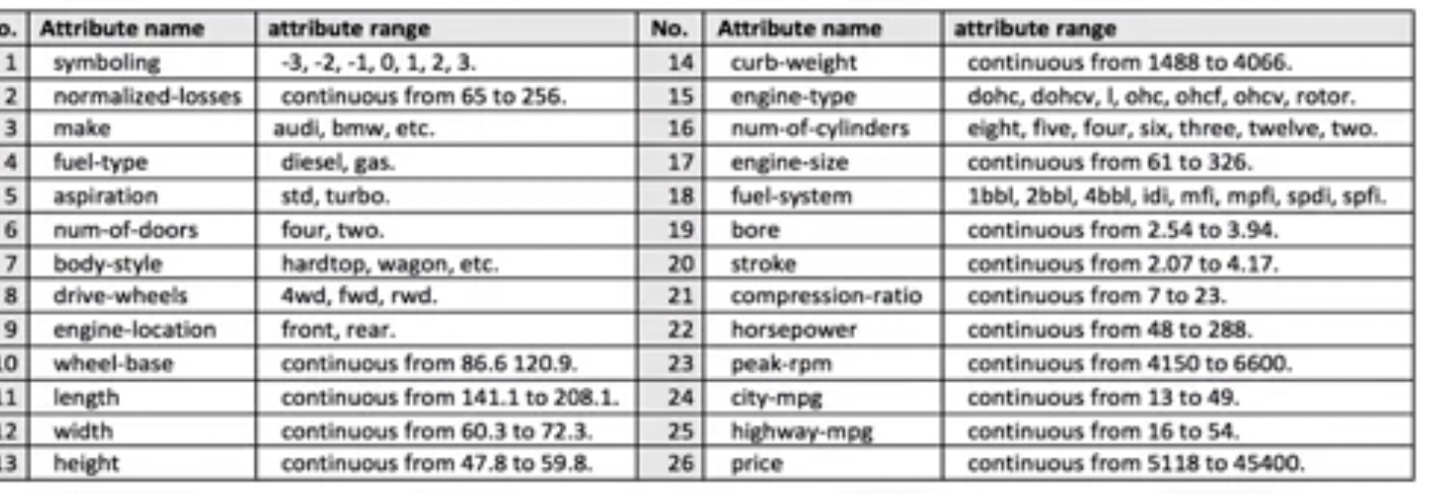
Each attribute in the dataset
Notes:
https://archive.ics.uci.edu/dataset/10/automobile
-Symboling – Insurance risk factor

Slide 9
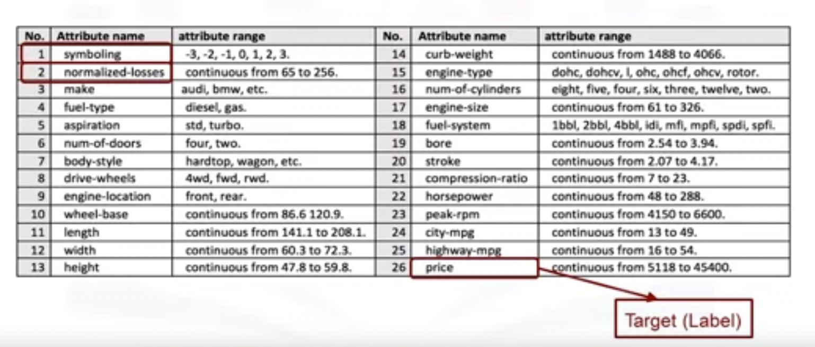
Each attribute in the dataset
Notes:
https://archive.ics.uci.edu/dataset/10/automobile
-Symboling – Insurance risk factor

Slide 10
Python Packages for Data Science

Slide 11
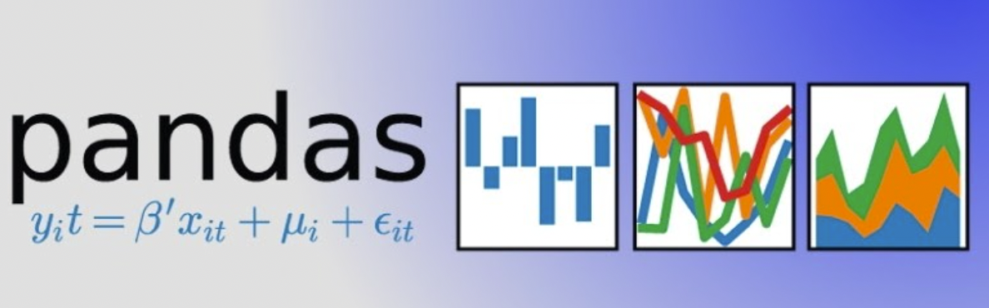


Scientific computing libraries in Python
Pandas (Data structures and tools)
NumPy (Arrays & matrices)
SciPy (Integrals, solving differential equations, optimization)

Slide 12

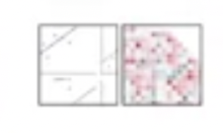
Visualization libraries in Python
Matplotlib (plots & graphs, most popular)
Seaborn (plots: heat maps, time series, violin plots)

Slide 13


Algorithmic libraries in Python
Scikit-learn (Machine Learning : regression, classification,..)
Statsmodels (Explore data, estimate statistical models, and perform statistical tests.)

Slide 14
What description best describes the library Pandas?
Uses arrays as their inputs and outputs. It can be extended to objects for matrices, and with a little change of coding, developers perform fast array processing.
Offers data structure and tools for effective data manipulation and analysis. It provides fast access to structured data. The primary instrument of Pandas is a two-dimensional table consisting of columns and rows labels which are called a DataFrame. It is designed to provide an easy indexing function.
Includes functions for some advanced math problems as listed in the slide as well as data visualization.

Slide 15
Importing and Exporting Data in Python

Slide 16
Importing Data
Process of loading and reading data into Python from various resources.
Two important properties:
Format
various formats: .cs, json, .xisx, hdf
File Path of dataset
Computer: /Desktop/mydata.csv
Internet: https://archive.ics.uci.edu/dataset/10/automobile

Slide 17
Getting Data

Slide 18
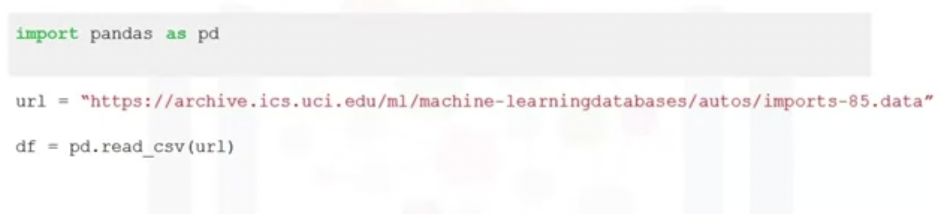
Importing a CSV into Python

Slide 19
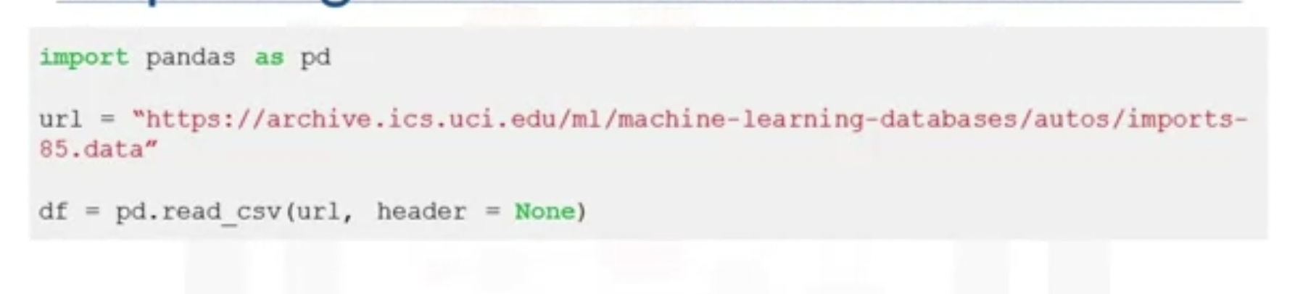
Importing a CSV without header

Slide 20
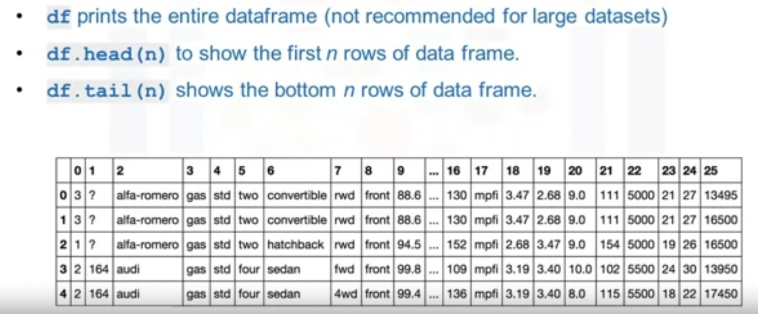
Printing the dataframe in Python

Slide 21
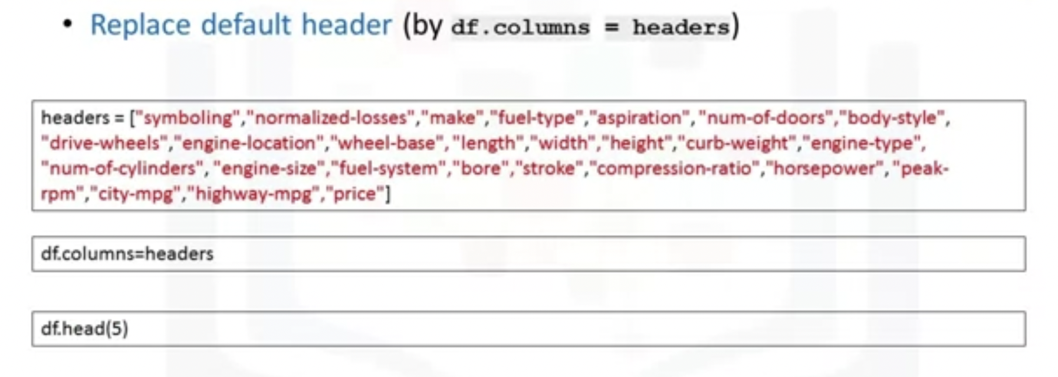
Adding headers

Slide 22
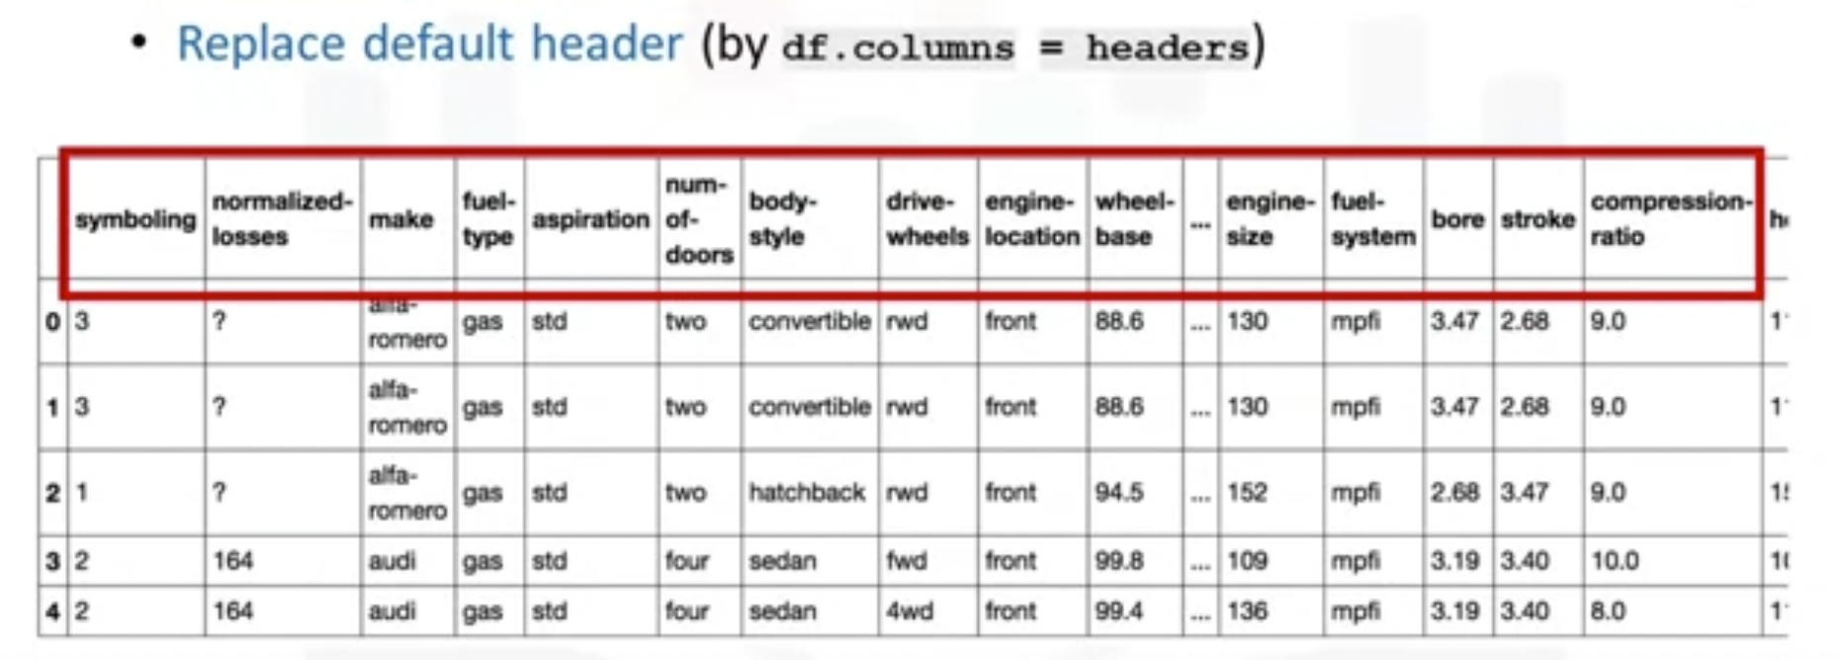
Adding headers

Slide 23
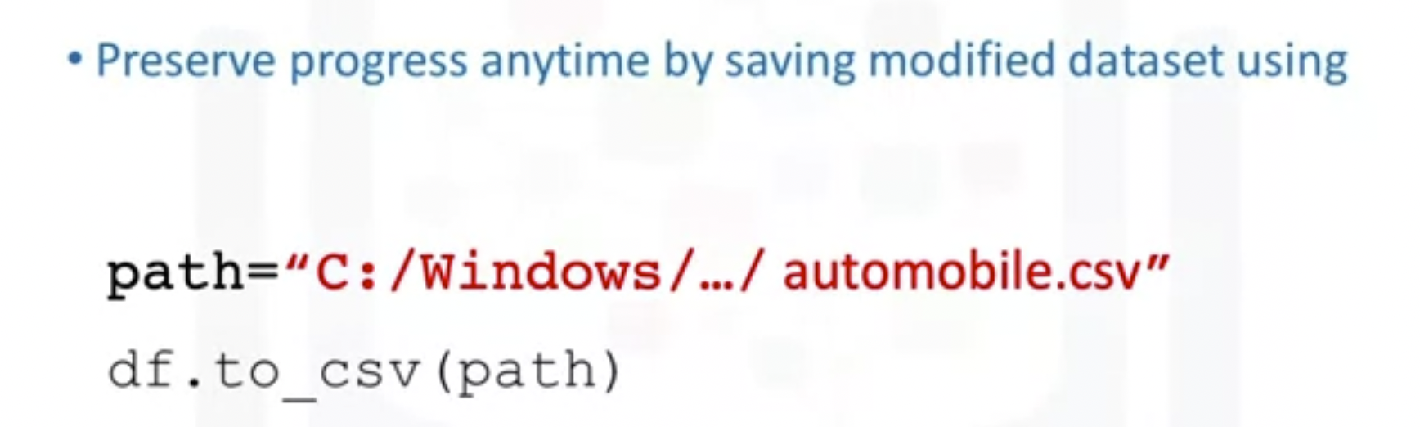
Exporting a Pandas dataframe to CSV

Slide 24
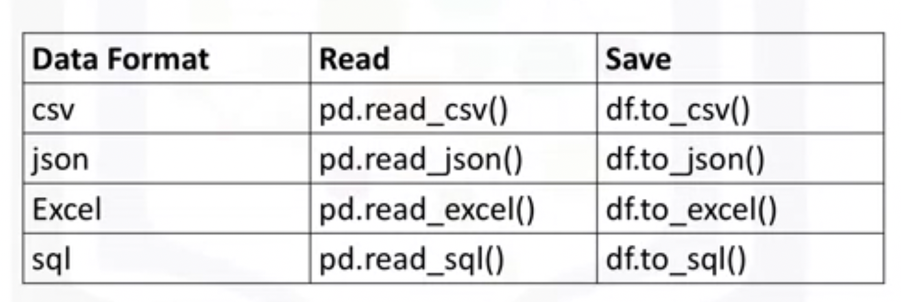
Exporting to different formats in Python

Slide 25
Getting Started Analyzing Data in Python

Slide 26
Basic insights from the data
Understand your data before you begin any analysis
Should check:
Data Types
Data Distribution
Locate potential issues with the data

Slide 27
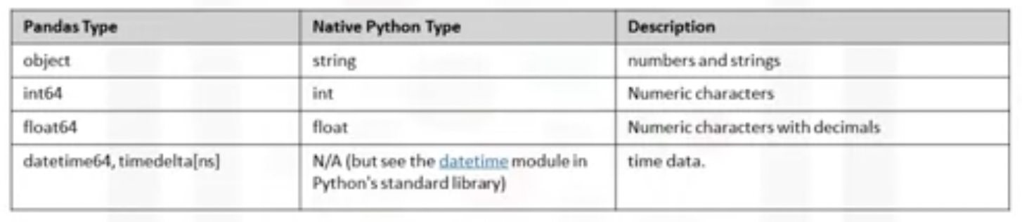
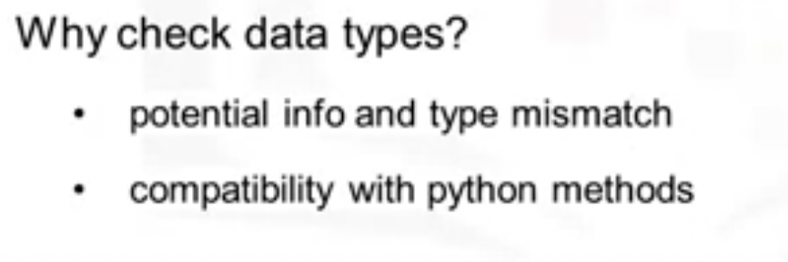
Basic insights from the data – Data types

Slide 28
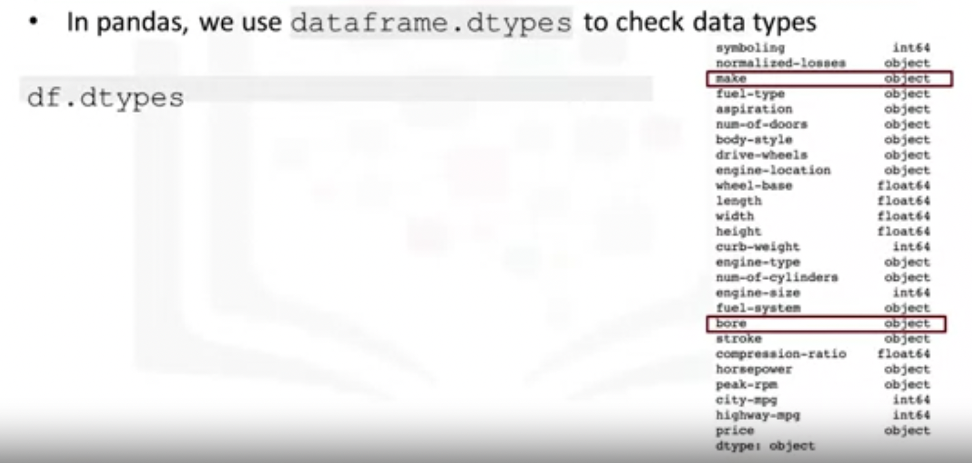
Basic insights from the data – Data types

Slide 29
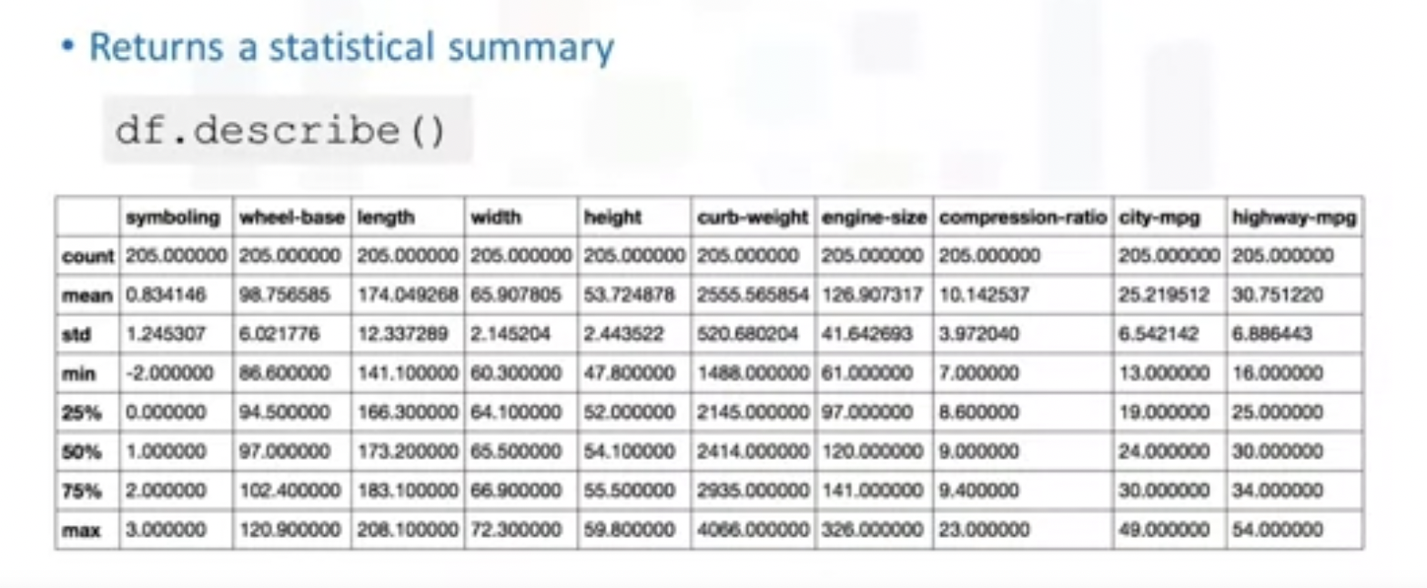
dataframe.describe()

Slide 30
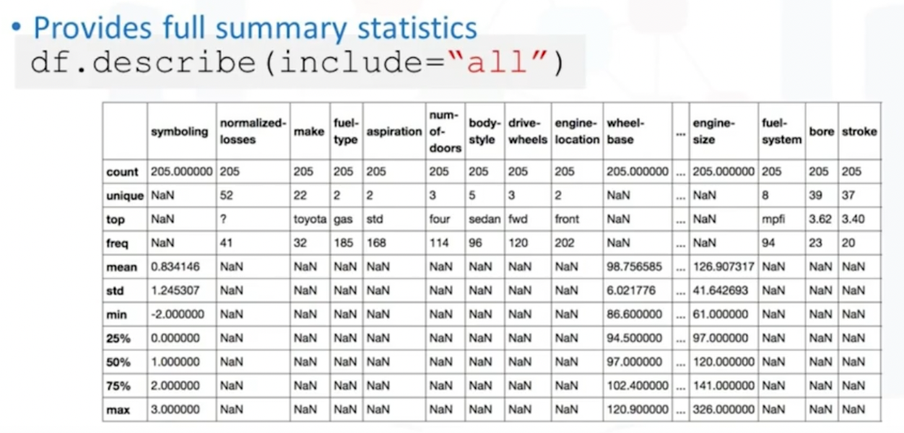
dataframe.describe(include=“all”)

Slide 31
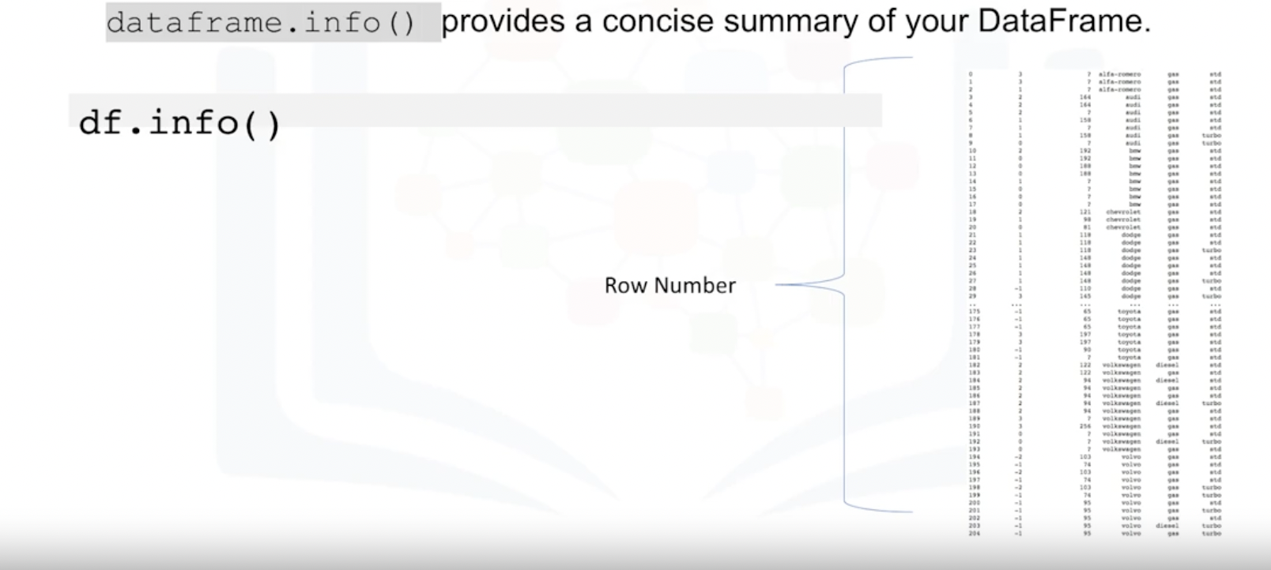
Basic insights from the data – Info

Slide 32
Accessing Databases with Python

Slide 33
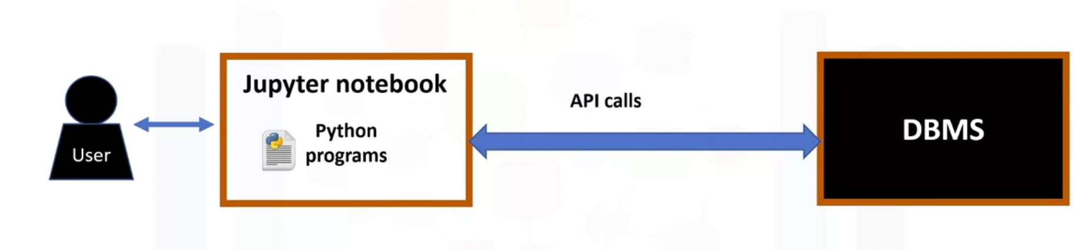
Accessing Databases with Python

Slide 34
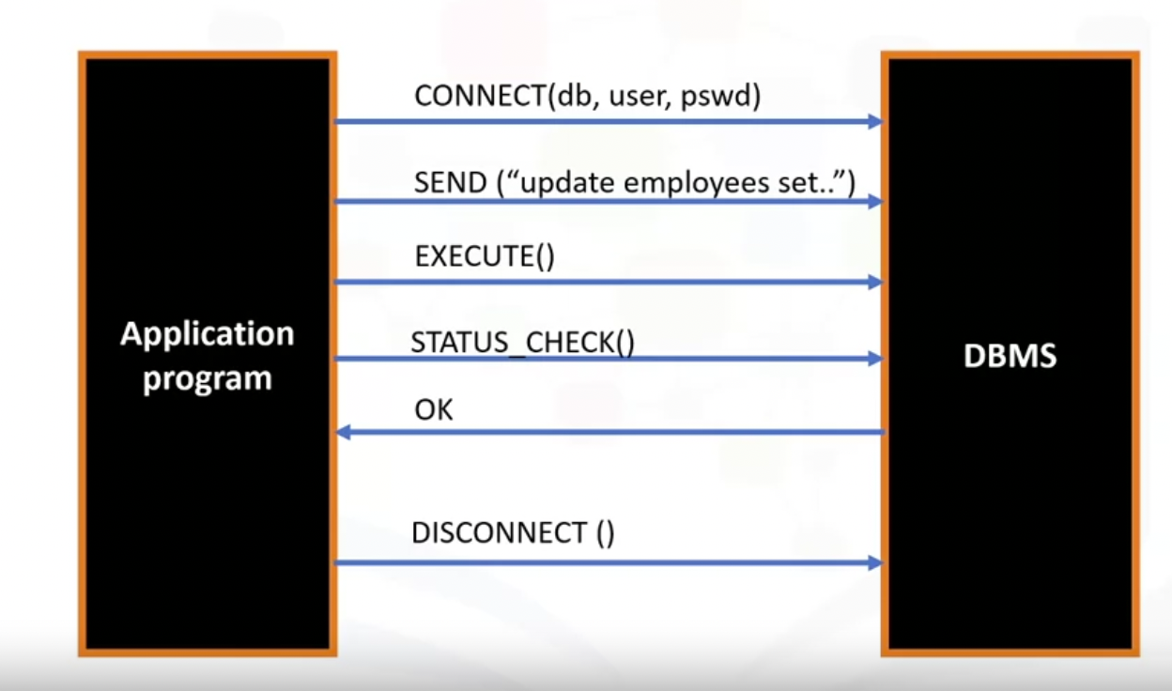
What is SQL API?

Slide 35
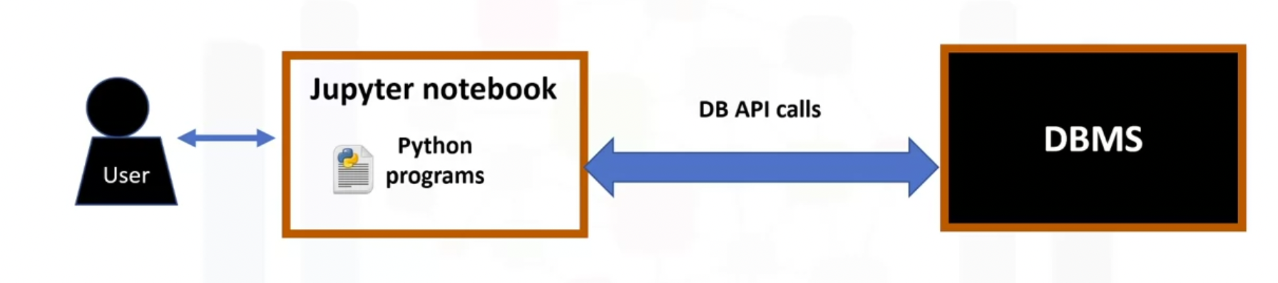
What is a DB-API?

Slide 36
Concepts of the Python DB API
Connection Objects
Database connections
Manage transactions
Cursor Objects
Database Queries

Slide 37
What are Connection methods?
cursor()
commit()
rollback()
close()

Slide 38
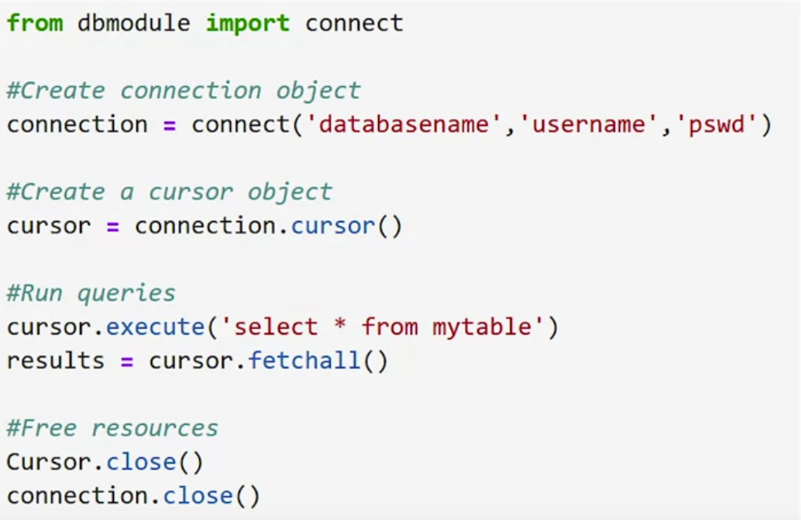
Writing code using DB-API

Slide 39
Lesson Summary
In this lesson, we have learned how to:
Define the Business Problem: Look at the data and make some high-level decision on what kind of analysis should be done
Import and Export Data in Python: How to import data from multiple data sources using the Pandas library and how to export files into different formats.
Analyze Data in Python: How to do some introductory analysis in Python using functions like dataframe.head() to view the first few lines of the dataset, dataframe.info() to view the column names and data types.

